Slide 1
Electric field and forces, Electric field lines, Electric Dipoles, Charged particles in an electric field.
.
Electric field and forces

Slide 2
We look at the Followings
Fields due to static and moving charges
Lines of force and electric field lines
Objects such as molecules, that are oppositely charged at two points or poles, DIPOLES
Behavior of charged particles in an electric field

Slide 3
Field
A Physical Phenomenon such as a force, potential, that pervades a region. Examples are Electric field, gravitational field, magnetic field, etc.

Slide 4
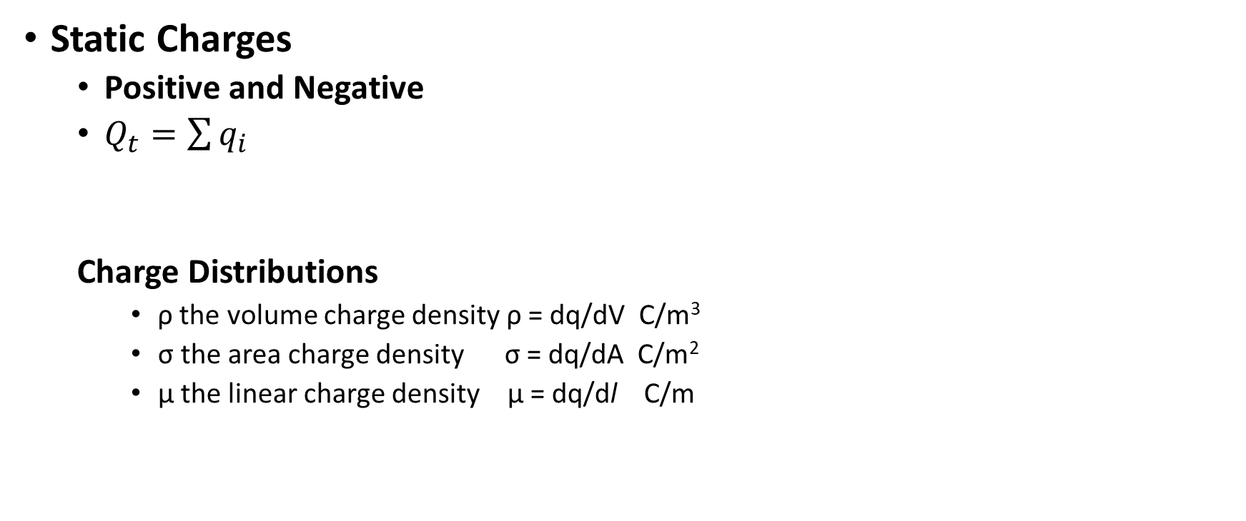
Charges and Dsitributions
Static Charges
Positive and Negative
$Q_{t}=\sum{q_{i}}$
Charge Distributions
ρ the volume charge density ρ = dq/dV C/m³
σ the area charge density σ = dq/dA C/m²
μ the linear charge density μ = dq/dl C/m

Slide 5

Electric Field
Any region where an electric charge experiences a force
$E_{1}= \frac{q_{1}}{4πε_{0}r_{1}^{2}}$
Vector
Direction
Magnitude

Slide 6
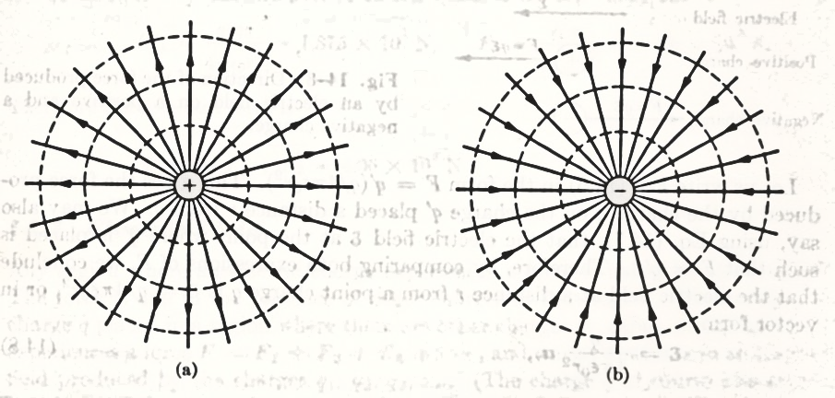
Electric field lines
Radially outward for +ve test charge
Radially inward for –ve test charge
Direction is from +ve to -ve

Slide 7
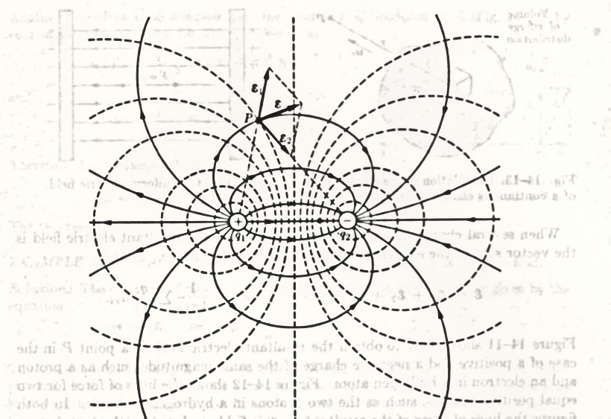

Field lines and Equipotential Surface
Potential $V=\frac{kq}{r}$

Slide 8
Characteristics of Electric field lines
Electric field lines radiate from the charges in 3 dimensions, hence an infinite number of lines could be drawn.
They provide information about the strength of the field. Note that near the charges the field lines are close and the electric field strongest. As distances increase from the test charge the filed strength is weaker. The number density (number of lines per unit area) passing perpendicular through an area is proportional to the magnitude of the electric field
Electric field lines are not always straight. Most often they are curved
Electric field lines always begin on a positive charge and end on the negative charge

Slide 9
Dipoles
Two separate charges that have the same magnitude but opposite signs
Dipole moment, p =qa
Importance

Slide 10
Dipoles
Fields in a dipole
E₊
y
E_{s}
S
E_
r₂
E_{p}
x
-q
a
+q
P
r₁

Slide 11
Along the axis of the dipole
by superposition principle
Fields at far point
Fields at near points
the field of large charges close together is the same as the field of small charges at large distances as the field depends only on the product qa.
a single isolated charge has its electric field fall as 1/r², a dipole with two charges has its field falls as 1/r³

Slide 12
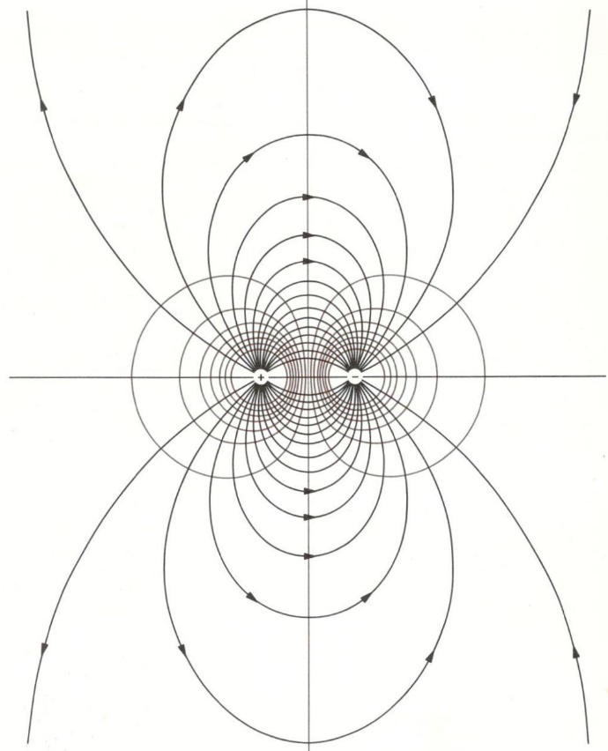
Field lines of the Dipole, field and equipotential lines

Slide 13
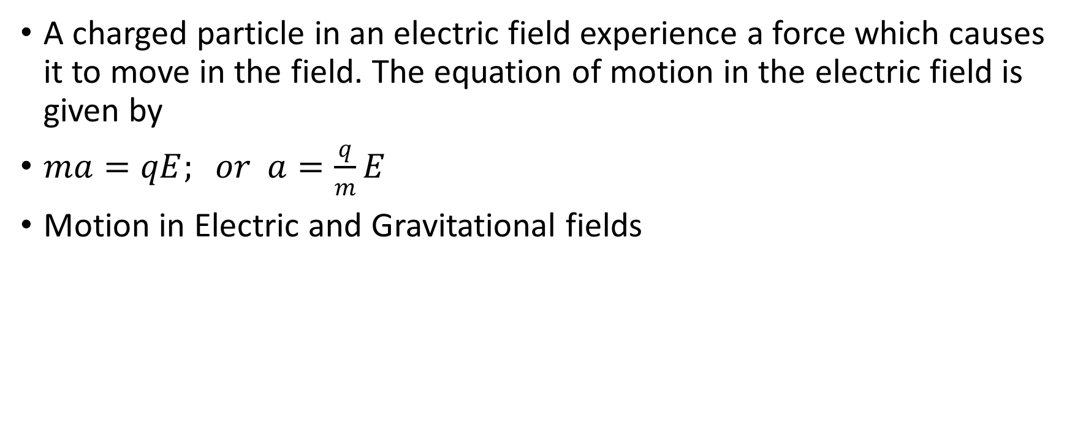
Motion of Charged Particle in E field
A charged particle in an electric field experience a force which causes it to move in the field. The equation of motion in the electric field is given by
$ma=qE; or a=\frac{q}{m}E$
Motion in Electric and Gravitational fields

Slide 14
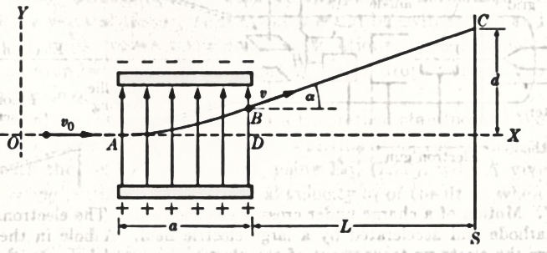
Motion in an E field

Slide 15

Equation of Parabola
Newton’s laws (x =ut +1/2 at²)
$x= v_{0}t, y=\frac{1}{2}\frac{q}{m}Et^{2}$
$y= \frac{1}{2}\frac{q}{m}\frac{E}{v_{0}^{2}}x^{2}$
$\tan{α= {\left(\frac{dy}{dx}\right)}_{x=a}=\frac{qEa}{mv_{0}^{2}} ≈\frac{d}{L} for BD≪d}$

Slide 16
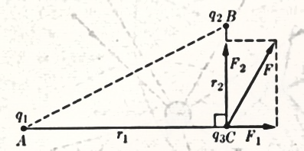

Example
Given that $q_{1}=1.5 x {10}^{−3}C; q_{2}=−0.5 x {10}^{−3}C; q_{3}=0.2 x {10}^{−3}C;AC=1.2m and BC=0.5m.$Calculate the electric field, E produced by charges q₁ and q₂ at C.

Slide 17
Two Approaches
Through Coulomb's law
Calculate E for each charges effects

Slide 18

Coulomb
$F_{1}= \frac{q_{1}q_{2}}{4πε_{0}r_{1}^{2}}=1.875 x {10}^{3}N$
$F_{2}= \frac{q_{2}q_{3}}{4πε_{0}r_{2}^{2}}=−3.5 x {10}^{3}N$
$F= \sqrt{F_{1}^{2}+ F_{2}^{2}}=4.06 x {10}^{3}N and E= \frac{F}{q_{3}}=2.03 x {10}^{7}N/C$

Slide 19

Calculate E₁ and E₂ due to q₁ and q₂ on q₃, and find the resultant
$E_{1}= \frac{q_{1}}{4πε_{0}r_{1}^{2}}=9.37 x {10}^{6}N/C$
$E_{2}= \frac{q_{2}}{4πε_{0}r_{2}^{2}}=1.8 x {10}^{7}N/C$
$E= \sqrt{E_{1}^{2}+ E_{2}^{2}}=2.03 x {10}^{7} N/C$

Slide 20

Angle or direction of the field
$\tan{θ= \frac{E_{2}}{E_{1}}}$ or $θ= \tan^{−1}\left(\frac{E_{2}}{E_{1}}\right)=62.5°$

Slide 21
Assignment
Due 2 weeks from this date

